Slide 1

SOCCER PLAYERS ANALYSIS AND PREDICTION
By: Soham Ghorpade
Email: soham.ghorpade@pace.edu
GitHub: GitHub_SohamGhorpade
2021

Slide 2

RESEARCH QUESTION
01
TEAM BUILDING
02
BUDGET
03
WIN PREDICTION
How to build the best 11 players team capable of competing at highest level?
How and which players to buy within the budget constraints?
How to predict the winning team based on previous performance?

Slide 3

MOTIVATION
Help sports club or choaces to assemble the best possible team and increase club valuation.
Leverage ML techniques to predict the winners and help coaches to architect their strategies and audience in sports fantasy.
Combining data tracking and visualizations to gain player’s development progress and decide scope of improvement.
CHAMPIONS

Slide 4
DATASET
2022
2019-2023
DATA ANALYSIS AND VISUALIZATION
FIFA_Sports-Statistics.com 18,000+ Player's data of 2022 season with 110 different variables related to potential, statistics, physical abilities, market value, clubs, nationality and leagues.
MATCH WIN PREDICTION
Datahub.io_Sports-Data_English_Premier_League 1389 rows of historic data from English Premier League from 2019 – 2023 with 106 different columns related to team, results and in-game statistics

Slide 5
LITERATURE REVIEW
​Title: Machine Learning for sport results prediction using algorithms
Goal: Machine Learning and Data Mining as techniques in sport reveals the essential contribution of technology in results and performance prediction.
​
Methodology: The methodology used in this study involved a critical analysis of recent research on sports prediction that have utilized various algorithms. The study aimed to compare different models for result prediction across various sports and to determine the viability of machine learning models for sport prediction. The researchers used a comparative approach to analyze the data, comparing the accuracy of different models across various sports. They also analyzed the features used in the models to determine which features were most predictive of match results.
​
Result: The study concluded that machine learning is a suitable methodology for sport prediction, as it generates predictive models that can accurately predict match results using predefined features in a historical dataset. Reference Link: Machine_Learning_for_sport_results_prediction_using_algorithms
​
​
​
​

Slide 6

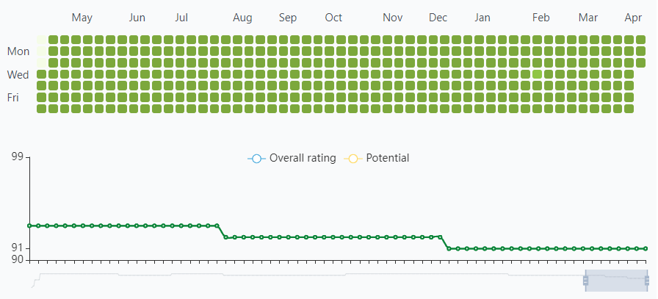
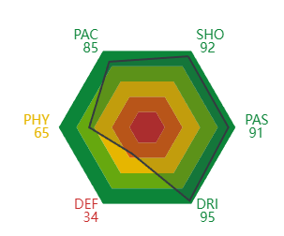
EXPLORATORY DATA ANALYSIS FORWARD
Lionel Andrés Messi Cuccittini
POSITION ON THE FIELD
SKILLS
PLACE OF BIRTH: Argentina
DATE OF BIRTH: 06-24-1987
AGE: 34
HEIGHT: 170 cm
SKILFUL FOOT: Left foot
Right Wing, Central Forward, Striker
Pace
Shotting
Passing
Dribbling
Defence
Phsicality

Slide 7

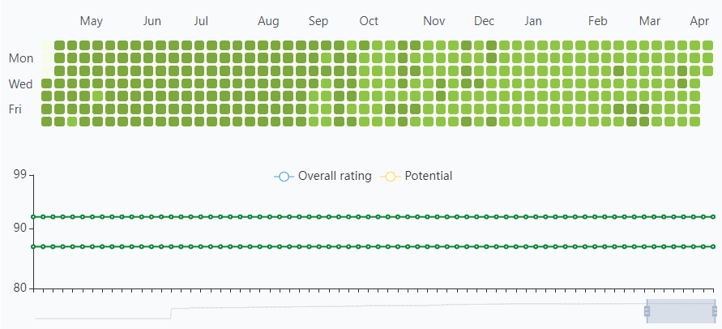
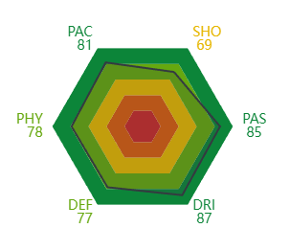
EXPLORATORY DATA ANALYSIS MIDFIELD
Frenkie de Jong
POSITION ON THE FIELD
SKILLS
PLACE OF BIRTH: Netherland
DATE OF BIRTH: 05-12-1997
AGE: 26
HEIGHT: 180 cm
SKILFUL FOOT: Right foot
Central Mid
Pace
Shotting
Passing
Dribbling
Defence
Phsicality

Slide 8

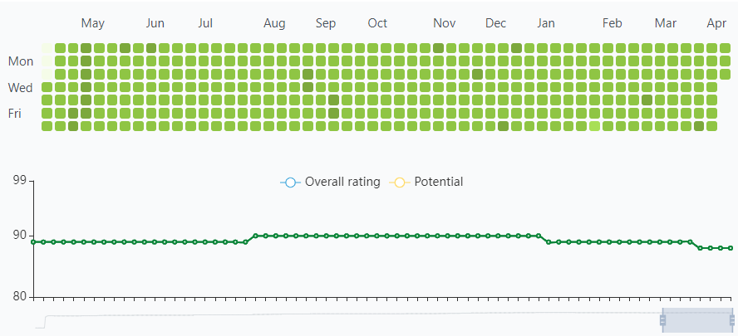
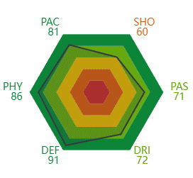
EXPLORATORY DATA ANALYSIS DEFENCE
Virgil van Dijk
POSITION ON THE FIELD
SKILLS
PLACE OF BIRTH: Netherland
DATE OF BIRTH: 07-08-1991
AGE: 30
HEIGHT: 193 cm
SKILFUL FOOT: Right foot
Central Back
Pace
Shotting
Passing
Dribbling
Defence
Phsicality

Slide 9

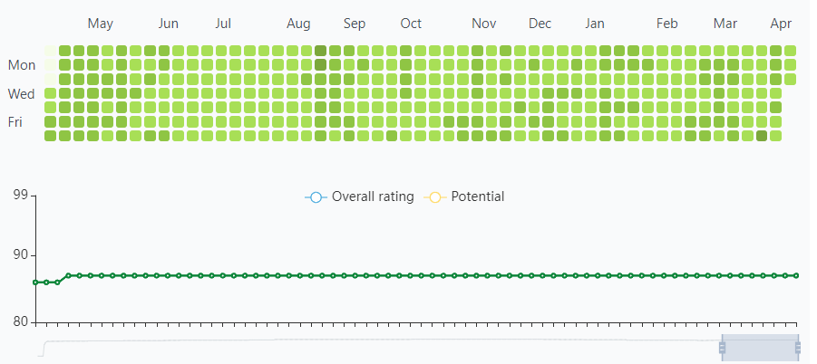
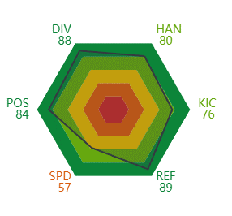
EXPLORATORY DATA ANALYSIS GOALKEEPER
Jan Oblak
POSITION ON THE FIELD
SKILLS
PLACE OF BIRTH: Spain
DATE OF BIRTH: 11-07-1990
AGE: 3
HEIGHT: 192 cm
SKILFUL FOOT: Right foot
Goal Keeper
Diving
Kicking
Reflexs
Handling
Positioning
Speed

Slide 10
ANALYSIS AND SELECTION OF TOP 11 PLAYERS
METHODOLOGY
MATCH WINNER PREDICTION
First selected the players from top 5 European leagues, then selected top players for each 15 common field positions in soccer game.
Filtered down the top 5 players from the top 10 list while comparing the potential rise and while applying other statistic filters
Used Python visualization libraries, Power BI and Tableau to visualize the data
Accumlated match data for the last 4 seasons including 106 columns.
Clean the data and get it ready for machine learning using pandas.
Make predictions about who will win a match using scikit-learn while implementing Naive Bayes, Random Forest and Logistic Regression algorithm
Used the accuracy to measure error and improve our predictions.

Slide 11

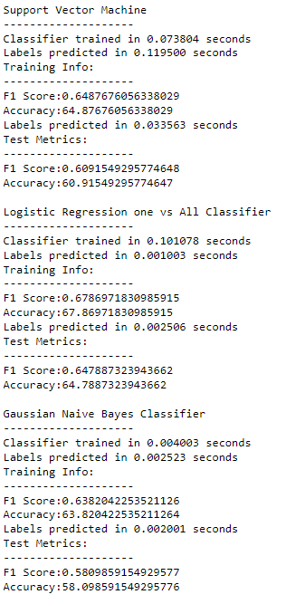
PERFORMANCE DATA

Slide 12

THANK YOU

